Slide 1
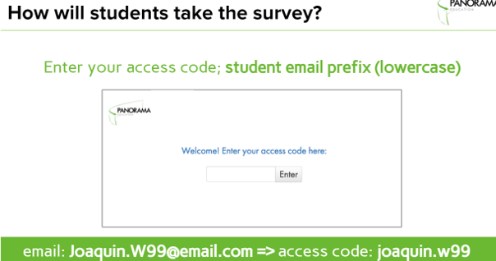

Survey Instructions
Survey Link: http://surveys.panoramaed.com/lodi
Access: There are two ways to access the survey. You can access it through the Clever Portal OR by using this link: http://surveys.panoramaed.com/lodi
Access Code: Students will use the prefix of their email in lower case letters.
Completion: Please press the submit button at the end of the survey and verify that you see this screen.

Slide 2
Survey Instructions
Survey Link: http://surveys.panoramaed.com/lodi
Access: There are two ways to access the survey. You can access it through the Clever Portal OR by using this link: http://surveys.panoramaed.com/lodi
What is it? This Survey assesses students’ Self-Efficacy, Social Awareness, Emotional Regulation, Sense of Belonging, Positive Feelings, and Challenging Feelings.
How long? It is 36 questions and should take about 15 minutes to complete.

